Slide 1
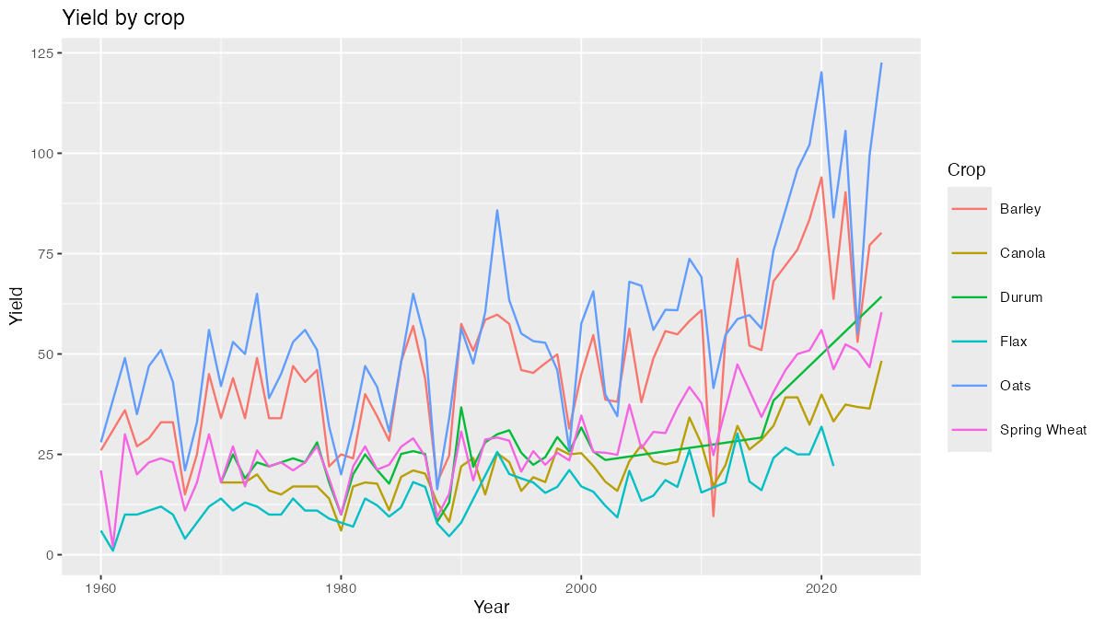
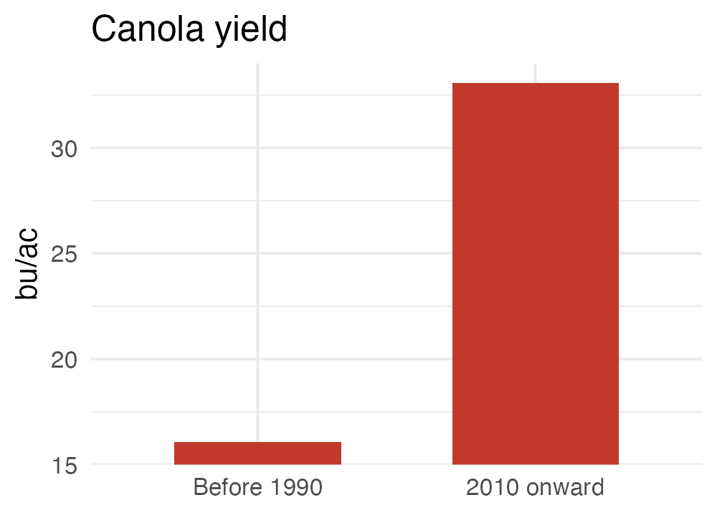
BAD
Yield by crop
AREC 261
Notes:
Canola is lost among six colours at 7 pt. On the right the truncated axis exaggerates the very comparison the talk is about: 16.1 against 33.1 is a doubling, but the bars differ about sixteen-fold.

Slide 2
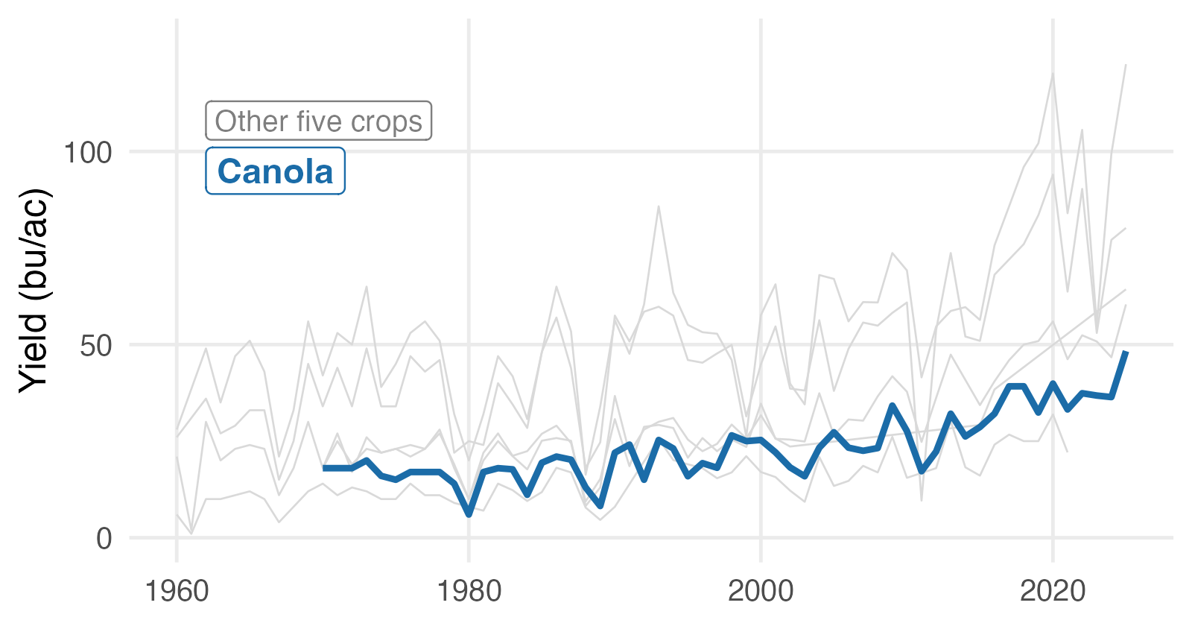
GOOD
Canola yields have doubled since 1990
AREC 261
Notes:
One chart, as large as the slide allows. Greying the other crops keeps the context visible without competing for attention.

