Slide 1
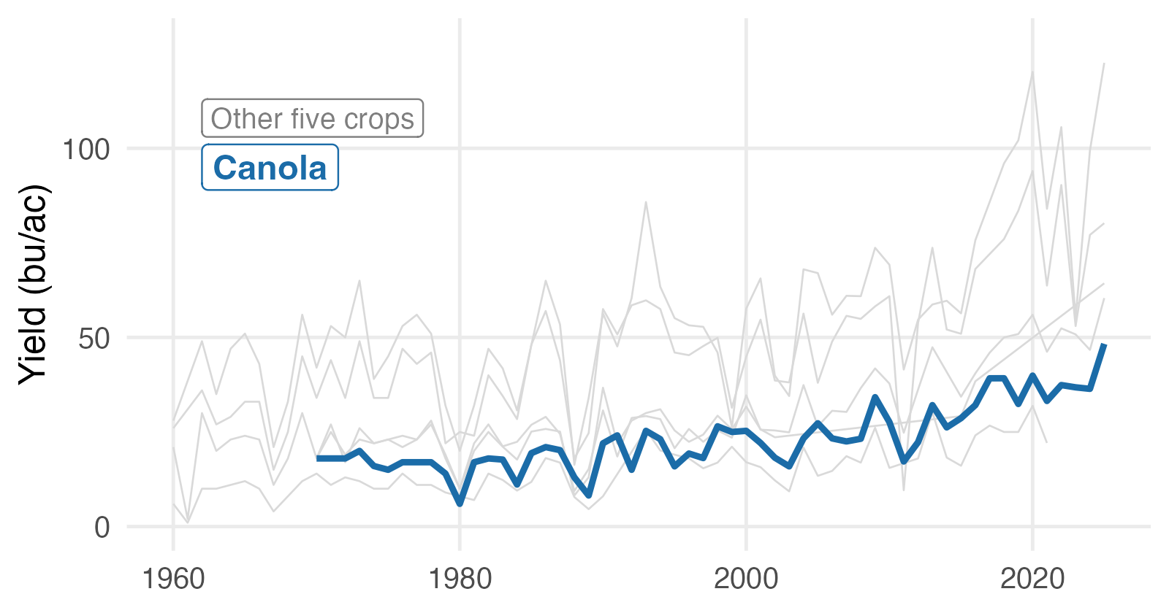
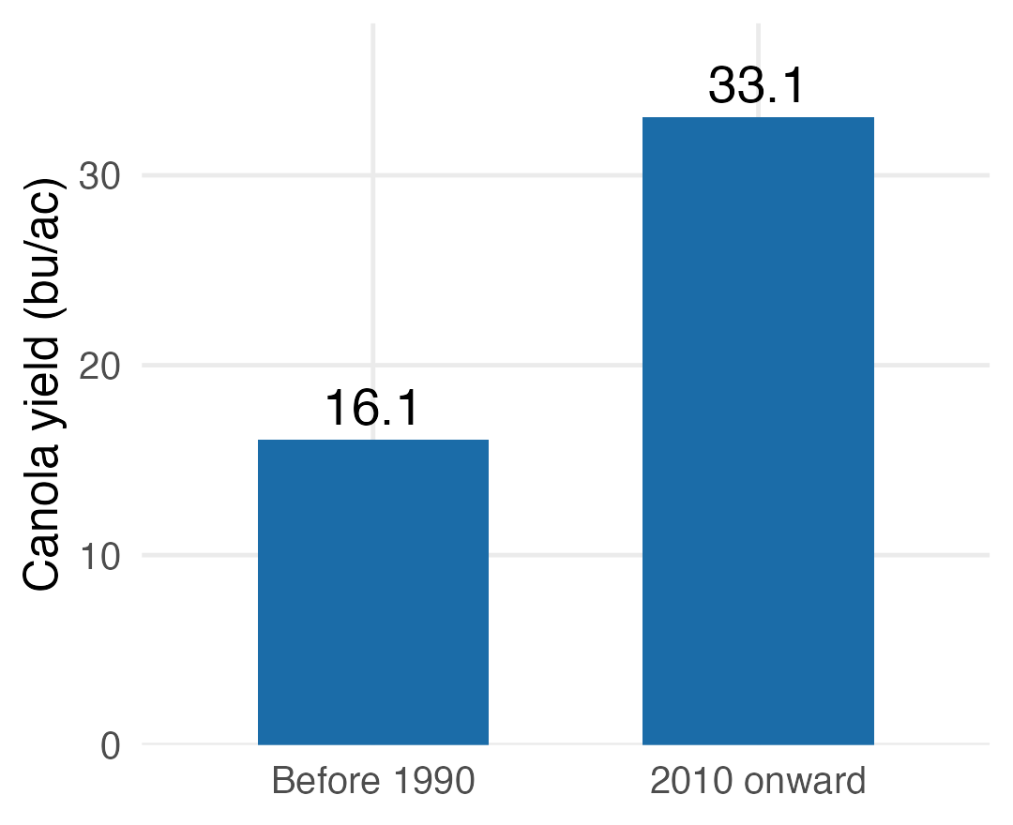
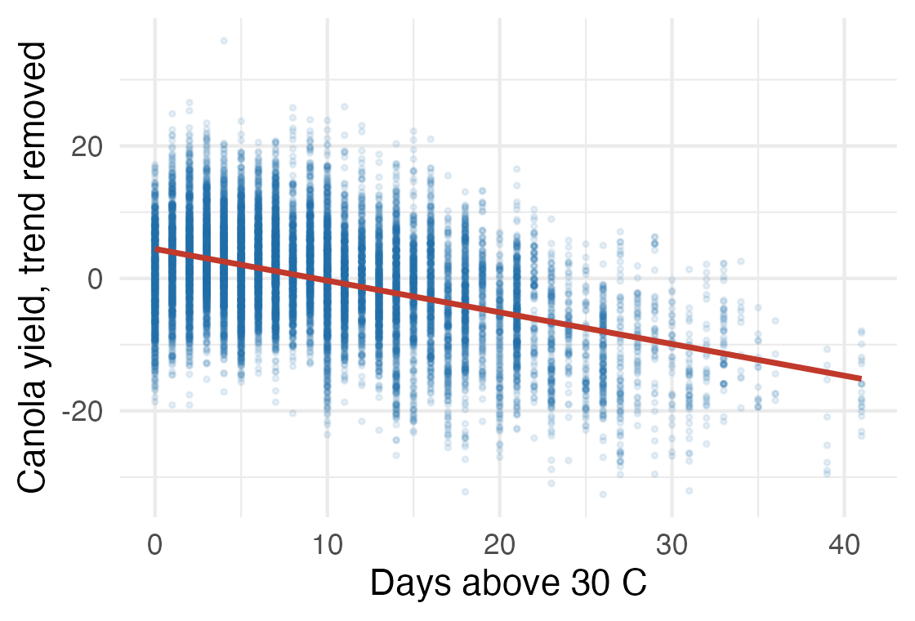
BAD
Results
• Yields have risen since 1960
• Canola rose fastest in relative terms
• Hot days reduce yield once detrended
• Precipitation matters less than expected
AREC 261
Notes:
Four findings, three charts and a bullet list on one slide. The audience does not know which one to take away, and this slide alone eats two of your five minutes.

Slide 2
GOOD
Canola yields rose the fastest since 1960
AREC 261
Notes:
First of the two. One finding in the title, one chart that shows it.

Slide 3
GOOD
Hot days reduce yield
AREC 261
Notes:
Second of the two. The bar chart from the bad slide is gone -- it repeated the line chart's finding, and a repeated finding does not earn a slide.

