Slide 1
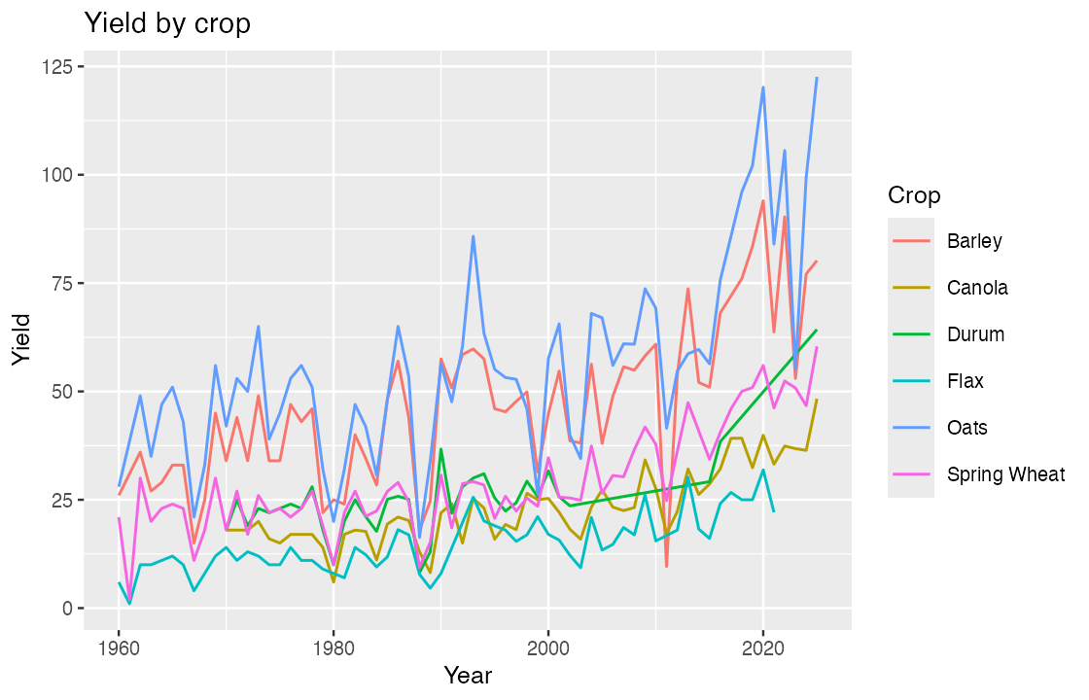
BAD
Yields over time
Notes:
Slide 1 of the bad pair: dark navy ground, ggplot's default grey panel and a six-colour legend.

Slide 2
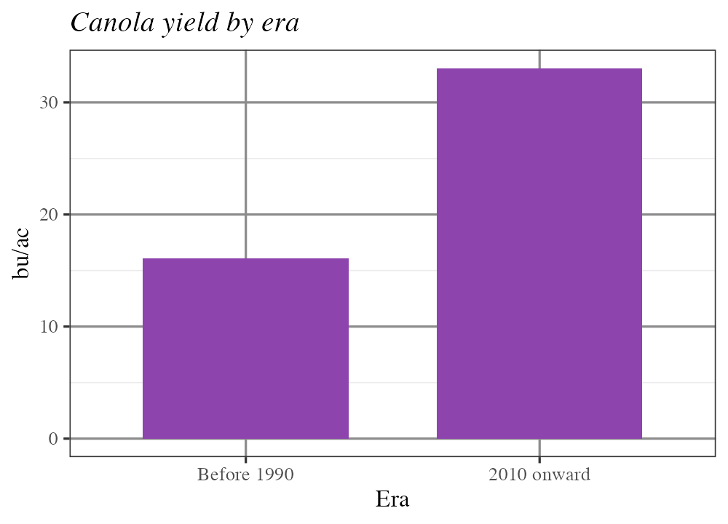
BAD
Canola by era
Next slide, new background, new palette, new font. Nothing carries over.
Notes:
Slide 2 of the bad pair: cream ground, purple bars, a serif face and an italic title. Two slides from the same talk that look like two different talks -- the audience has to re-orient instead of following the argument.

Slide 3
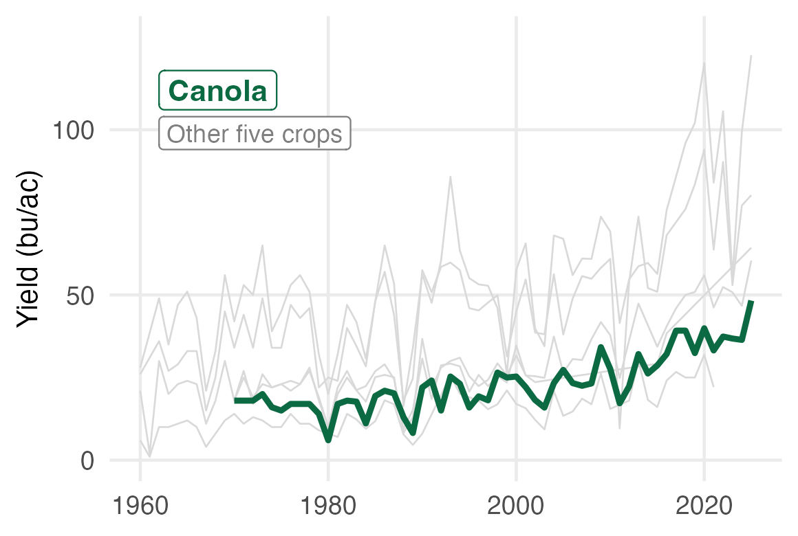
GOOD
Canola has risen faster than the other five crops
AREC 261
Notes:
Slide 1 of the good pair: USask template, green for the subject, grey for context, no legend.

Slide 4
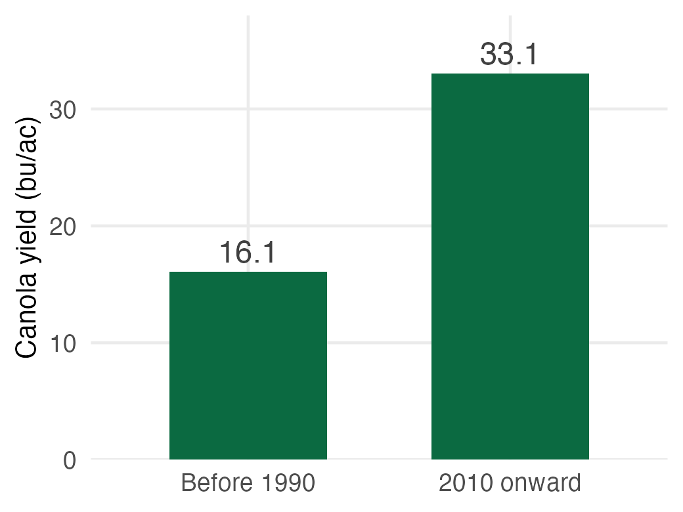
GOOD
The gain is a doubling: 16 to 33 bu/ac
AREC 261
Notes:
Slide 2 of the good pair: the ground, the type and the green are unchanged, so the audience reads the number instead of re-reading the design. Set the theme once at the top of your script and every chart inherits it.

