Slide 1
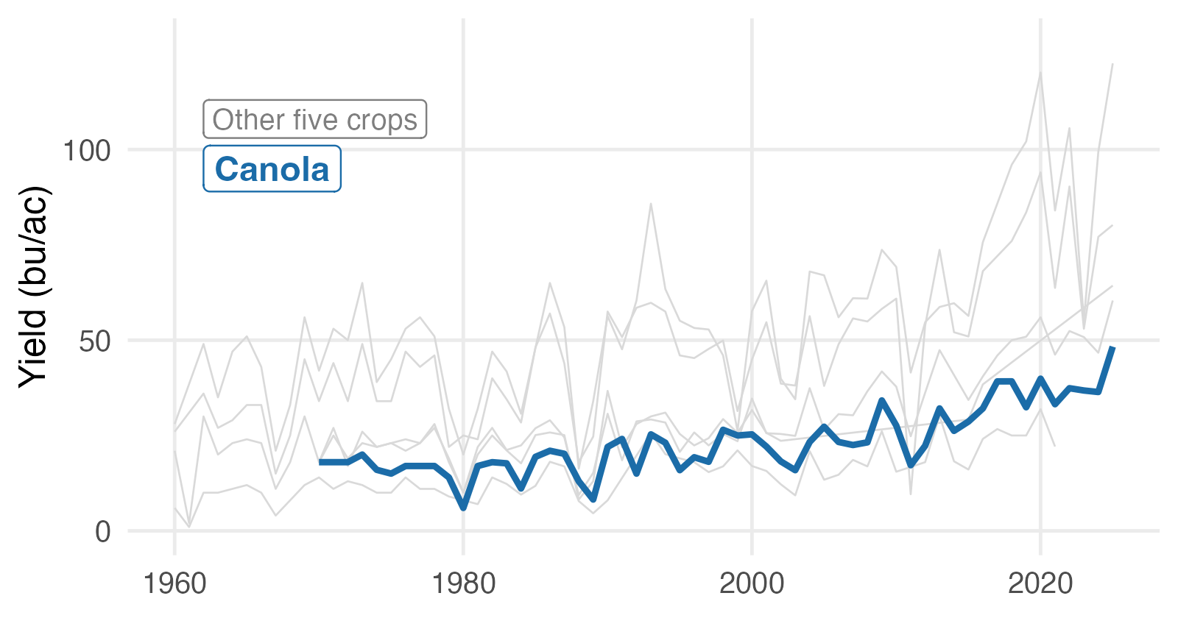
BAD
Canola yields have doubled since 1990
Notes:
A stock template with a coloured wedge and a shaded title band. The decoration takes a third of the slide and adds nothing, and the chart's white background cuts a hard rectangle out of the dark fill. Same headline as the good slide, so the template is the only thing that changed.

Slide 2
GOOD
Canola yields have doubled since 1990
AREC 261
Notes:
The USask template. The brick tiling, the logo and the footer are the whole design, and they stay out of the way: the chart is the only thing on the slide with colour. This is what a clean template looks like -- you do not have to design anything.

